Slide 1
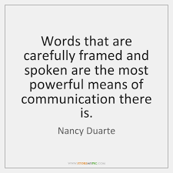
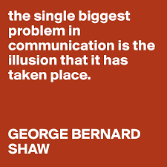
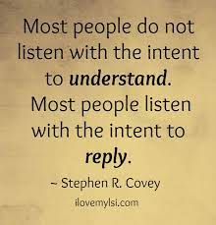

Slide 2

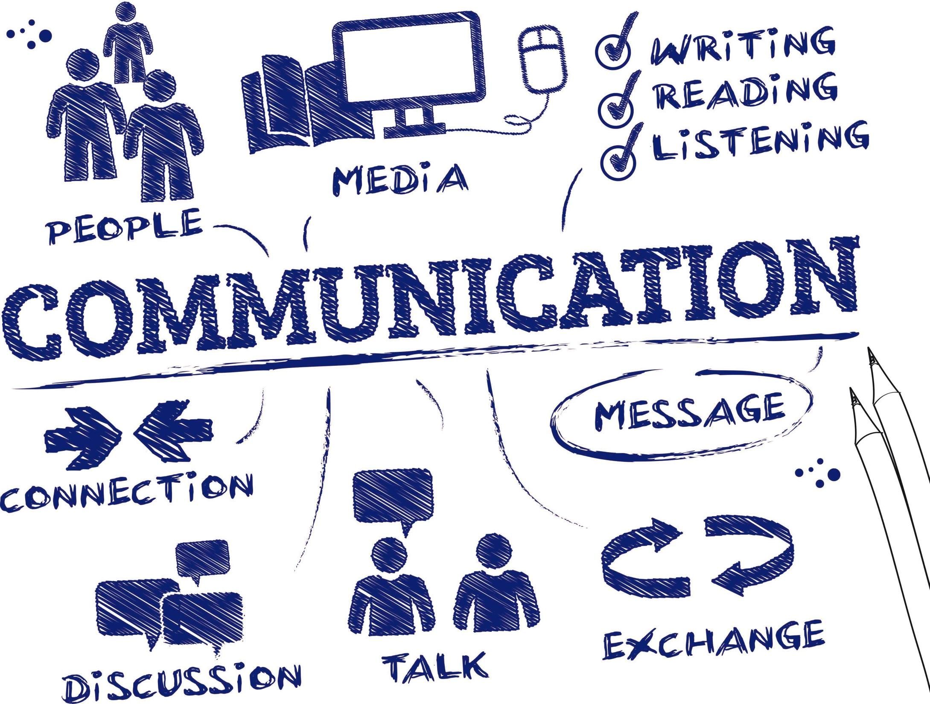
« Effective communication »

Slide 3
Learning outcomes:
By the end of this session, you should be able to:
Develop effective communication and presentation skills
Define and take part in an active listening
Plan a persuasive essay
Use linking words (cohesive devices) correctly

Slide 4
Outline:
Effective communication: definition & benefits
Effective speaking: Words, voice and body language
Active listening: definition, benefits and types
Quiz
Persuasive Essay: structure
Linking words: use and meaning
CCCA3 Project: Presentation skills

Slide 5
During important communications, have you experienced any of the following?
  Feeling misunderstood
Being so caught up in what you have to do
Speaking over others or finishing their sentences
Difficulty expressing your feelings or opinions
Finding yourself diverting or ending conversations that don’t interest you
Grappling to understand things from someone else’s point of view
Struggling to resolve problems without losing control of your emotions

Slide 6
If you answered yes to one or more questions, you could benefit from refreshing your communication skills!

Slide 7

How would you describe effective communication?

Slide 8
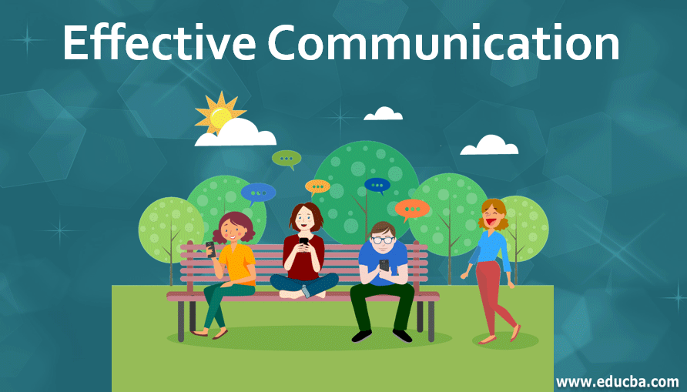
Effective communication:
Effective communication is a technique that enables you to verbally and nonverbally communicate in a way that makes you agreeable and easy to understand.
The presentation of views by the sender in a way best understood by the receiver.

Slide 9

Effective communication skills are essential for healthy relationships, whether at home, work or in business or social situations. People are often more inclined to work with you and help you reach your goals if you communicate effectively.

Slide 10

Communication skills inherent or learned?

Slide 11

Talking Or communicating?
Any difference??
Talking is uttering words with the goal of getting a message across; sometimes it works, sometimes it doesn’t.
Communicating refers to one step further in the process: it is the successful transmission of a message.

Slide 12
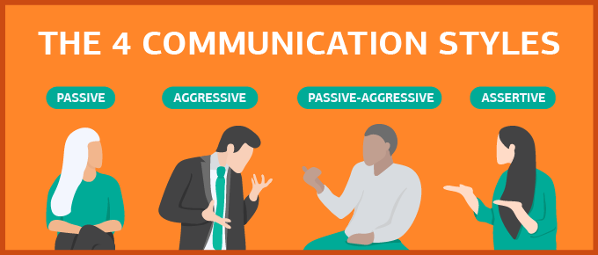
Communication styles

Slide 13
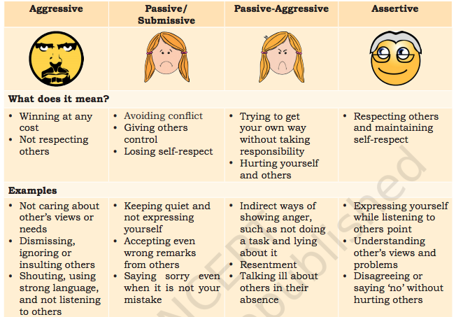

Slide 14
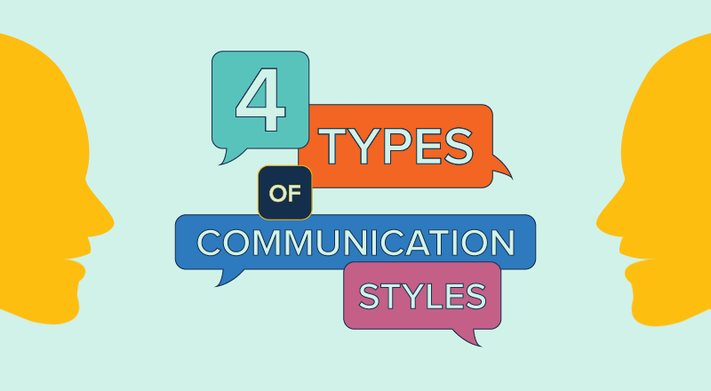
Guess the communication style
1. “I just want to keep the peace”
Passive
2. We are equally entitled to express ourselves respectfully to one another.”
assertive
3. it’s all your fault.”
aggressive
4. “That’s fine with me, but don’t be surprised if someone else gets mad.”
Passive aggressive
Assertive
5. “I respect the rights of others.”
6. I’ll get my way no matter what.”
Aggressive
7. “It really doesn’t matter that much.”
Passive
8.Sure, we can do things your way” (then mutters to self that “your way” is stupid).
Passive aggressive

Slide 15
How to be an Active communicator?

Slide 16
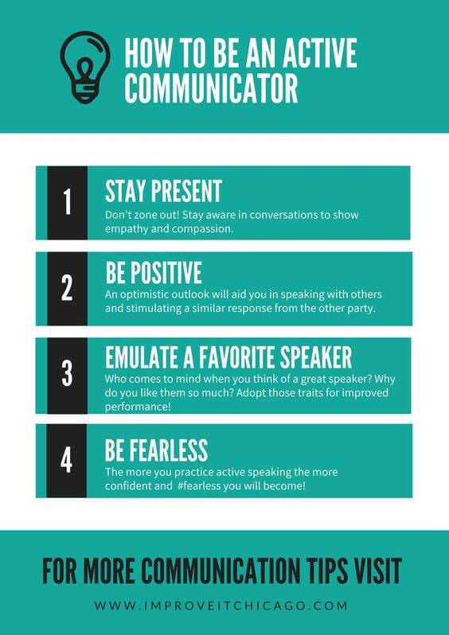

Slide 17


What are the Benefits of effective communication?
What are the costs of poor communication.

Slide 18
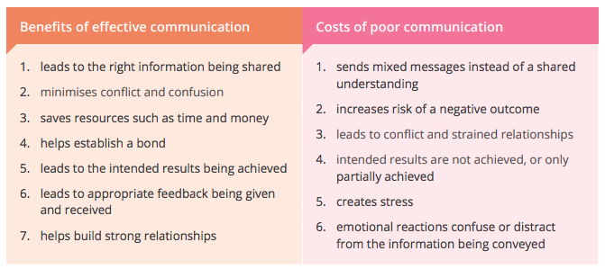

Slide 19
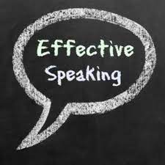
Effective speaking:
Speaking effectively is defined as speaking in such a way that your message is clearly heard and, if possible, acted upon. There are two main elements to speaking effectively: what you say, and how you say it.
What you say means your choice of words. The words you might use when chatting to a friend are likely to be quite different from those used in a formal presentation or interview.

Slide 20

Similarly, the way that you speak will also vary in different situations. However, there are also likely to be some common factors: for example, whether you naturally talk quietly or loudly, and how you use body language.

Slide 21
Aspects of Effective Speaking:
Effective speaking means being able to say what you want to say in such a way that it is heard and acted upon.
What are the three main elements of effective speaking?

Slide 22

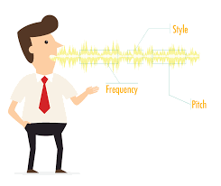
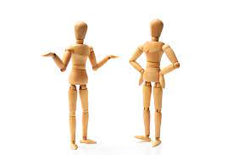
Your other non-verbal communication, particularly body language
The words you use
Your voice

Slide 23
Choosing Your Words:
What you say—the words you choose—matters:
Your audience. The words you choose will be different if you are talking to 200 people at a conference, a trusted colleague, your boss, or your children. You need to think about your audience’s overall level of understanding of the subject, and also the type of language that you use.
Shorter sentences are easier to process and understand. Using shorter sentences also creates urgency.
Simpler words are also easier to understand. If you cannot explain something in simple terms, you have probably not understood it yourself. This is particularly important if your audience are not all native speakers of the language.

Slide 24
Your Voice:
Your voice can reveal as much about your personal history as your appearance. The sound of a voice and the content of speech can provide clues to an individual's emotional state.
For instance, if self-esteem is low, it may be reflected by hesitancy in the voice. A shy person may speak quietly, but someone who is confident in themselves will be more likely to have command of their voice and clarity of speech.

Slide 25
Body Language:
A considerably amount of communication—some estimates suggest over 50%—is non-verbal. Tone of voice, pace and emphasis are all part of non-verbal communication.
However, your body language is also important. This includes how you stand, your facial expressions, the way you use your hands to emphasize your speech, and even whether and with whom you make eye contact.
When you are presenting, strong, positive body language becomes an essential tool in helping you build credibility, express your emotions, and connect with your listeners. It also helps your listeners focus more intently on you and what you're saying.

Slide 26
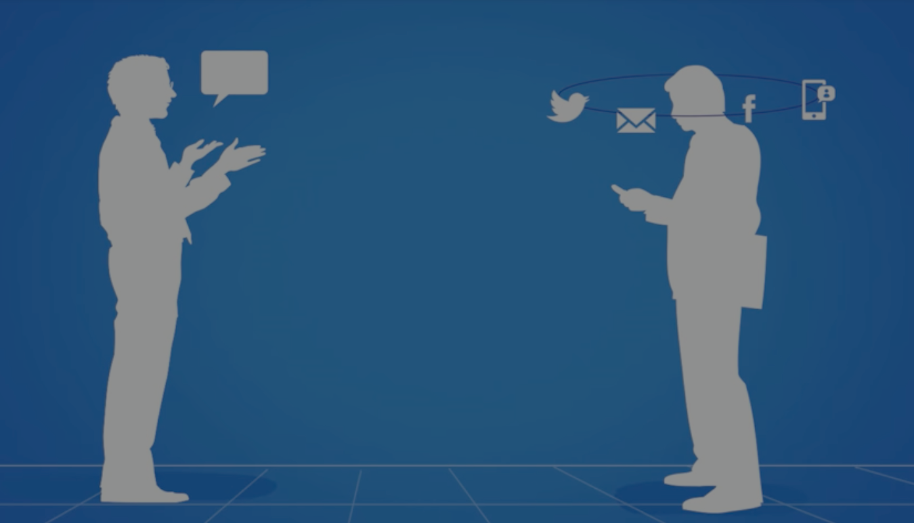
Do you sometimes…
Talk when others are talking?
Often have to ask people to repeat themselves?
Often interrupt others when they’re talking?
Jump to conclusion before the speaker is finished talking?

Slide 27
If you answered “yes” to one or more of these questions, you may need to improve your listening skills.

Slide 28
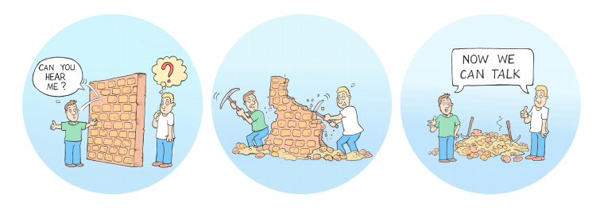
Active listening:
One of the most critical skills in effective communication is active listening.
Developing this soft skill will help you build and maintain relationships, solve problems, improve processes and retain information such as instructions, procedures and expectations.

Slide 29
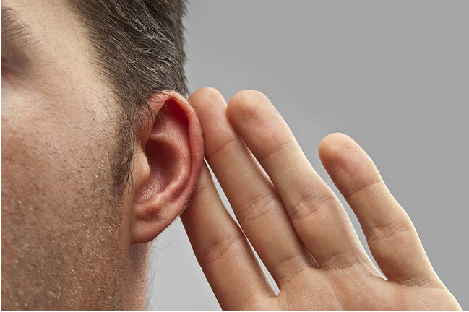
Active listening:
Listening beyond words in order to understand a deeper message.
Attentively seeking to understand a speaker’s message, rather than passively hearing the words a speaker says.
Reducing and ignoring external distractions

Slide 30
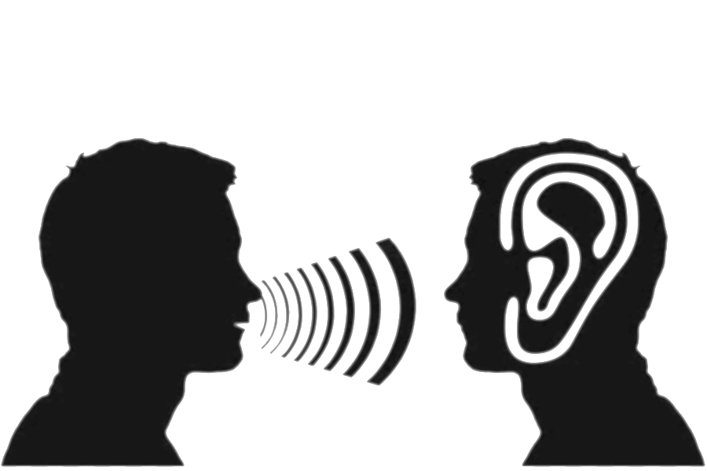
A time you weren’t listened to
What impact has this on you ? How did you feel?

Slide 31

Difference between Hearing and Listening
Hearing | Listening
Hearing is one of the 5 senses and it just happens all the time, whether you like it or not, unless you have a hearing problem. | Listening requires concentration so that your brain processes meaning from words and sentences.
Hearing simply happens (passive) | Listening requires attention leads to learning (active)
Hearing is a skill where you use your ears only | Listening uses different senses, like the sense of hearing, seeing, or sense of touch
Hearing is an involuntary act, meaning you don’t choose to do it. That’s why you can hear people talking, but you can choose not to listen and focus on what they are saying | Listening is voluntary, as you choose to listen and focus on what they are saying
Physiological | Psychological
Hearing is effortless (Concentration is not required) | Listening is intentional (Concentration is required)

Slide 32
Facts about Active Listening
- We spend around 60% of our communication time listening.
- 85% of what we have learned is through listening (not talking or reading).(Shorpe)
- 75% of the time, we are distracted, preoccupied or forgetful. (Hunsaker)
- After listening to someone talk, we can immediately recall about 50% of what was said. Even less if we didn’t like the subject or the person! (Robinson)
- One hour later, we remember less than 20% of what we heard. (Shorpe)
- We listen at 125-250 words per minute, but think at 1000-3000 words per minute. (High Gain, Inc.)

Slide 33
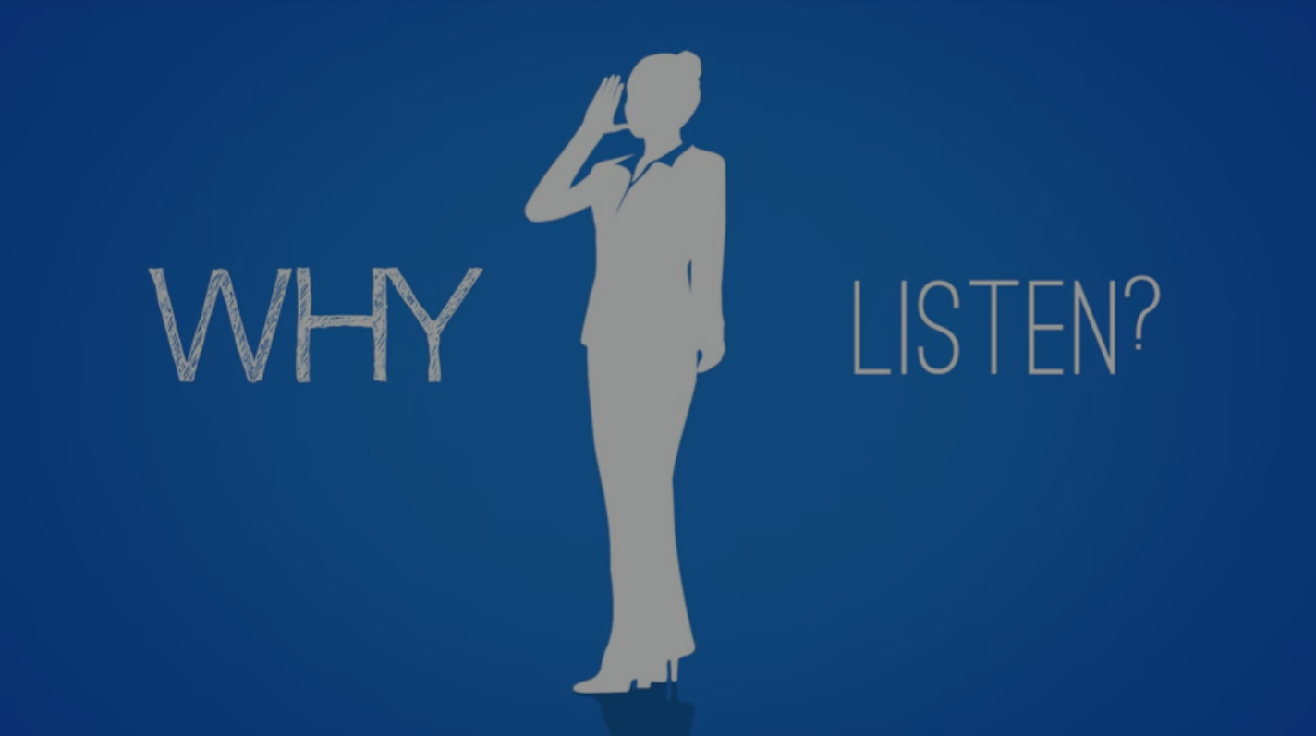
Benefits of Active listening
Provides verbal and non-verbal feedback to show their sincere investment in what the speaker is sharing.
Tends to open people up: get them to say more
Increases understanding of the speaker’s point of view, not necessarily agree with or support it.
Builds trust within a conversation thereby allowing the speaker to communicate more easily, openly and honestly.

Slide 34

Types of Listeners
Non-listeners
Passive listeners
Evaluative listeners
Active listeners

Slide 35
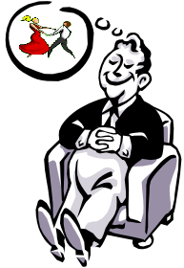
Non-listeners
Hear what is said but do not listen
Have a lot on their minds and want to let it out
Prefer hearing themselves talk, sometimes endlessly
Fake attention

Slide 36
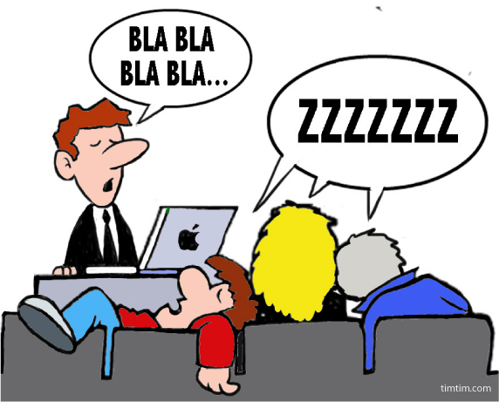
Passive listeners
Disconnected and unreceptive
Appear laid-back and calm
Use little energy or effort
Rarely establish eye contact
Fake attention

Slide 37

Evaluative listeners
Use logic to understand the content
Distant themselves emotionally from the subject
Mostly judgmental as they presume the meaning before the speech is delivered.
Assess the message in terms of its usefulness

Slide 38

Active listeners
Listen to understand
Show interest in what is being said
Pay absolute attention and do not interrupt
Keenly listen to the message and the way it has been delivered
Involve themselves actively in the communication process.
Ignore everything around and make the speaker the center of their universe

Slide 39

Now you may wonder which type you should aspire to become. Obviously, you should become an active listener, thus an effective communicator.

Slide 40
Example Scenarios
🗹
I repeat points back during a meeting to clarify my understanding.
🗹
When people talk to me about sensitive subjects, I do my best to put them at ease.
🗷
I feel uncomfortable with silence during conversations.
🗷
To get people elaborate on their point, I ask open questions.
🗹
When someone talks to me, I nod and say things like ‘OK’ and ‘uh-huh’ occasionaly.
🗹
If the person is struggling to explain something, I jump in with my own suggestions.

Slide 41


Slide 42
Active listening quiz
1- Why is it called Active listening?
a- you stay active rather than sitting around.
b- it requires a lot of multitasking.
c- you use your eyes and brain as well as your ears.
d- you look very focused.
2- Which one is NOT part of Active listening?
a- look at the person.
b- encourage the person to talk.
c- use empathy.
d- give advice.
🗹
🗹

Slide 43
3- Which is NOT a good reason to use Active listening?
a- to manipulate your friend
b- to make sure you understand what to do
c- to have time to think of what you want to say
d- to get more information
4- Why do you need to use your eyes when actively listening?
a- you don’t
b- to make the speaker think you are tuned in
c- to observe the speaker’s body language
d- none of these
🗹
🗹

Slide 44
5- Which of the following is a sign of Active listening?
a- paraphrasing, or summarizing what someone has said
b- changing the subject
c- interrupting, or talking over someone
d- being totally silent while someone else talks
6- Why is Active listening a “two-way street”?
a- because if you listen to others, you can force them to listen to you
b- because it means you are walking and being active while you listen
c- because both the listener and the speaker give and receive something
d- because two people are saying the same thing at the same time
🗹
🗹

Slide 45

Writing
PERSUASIVE ESSAY

Slide 46
Persuasive Essay:
Definition:
A persuasive essay is a type of academic writing where you use logic and arguments to convince readers of your point of view, using solid evidence such as research, stating facts, examples, and quotes from experts.

Slide 47
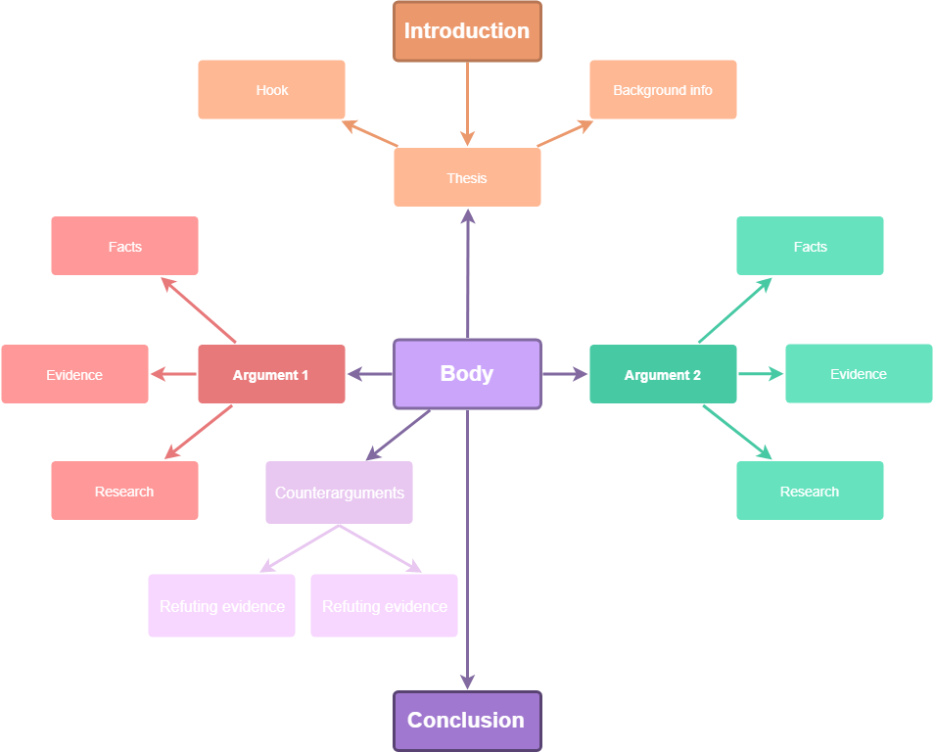
Structure:

Slide 48
Structure:
Introduction: hook, background, thesis.
Body: 1-2 paragraphs, each with an argument and supporting evidence.
Body: 1 paragraph, with your opponent’s arguments and your counter arguments on why you still disagree.
Conclusion: sum up your points, restate your thesis, and leave readers with food for thought.

Slide 49
In the introduction:
Describe the problem and state the point you’re trying to make. Also, think of a strong hook for readers to understand why they should care.
In body paragraphs:
Support your thesis with evidence from credible resources. Leave one paragraph for counterargument: what your opponents have to say on the issue and why you still disagree. Use logical arguments and research to convince readers.
In the conclusion:
Wrap up your persuasive essay by restating your thesis. You may end it with a question for readers to think about.

Slide 50
How to format a persuasive essay:
Choose a topic and your position about it.
Think of arguments you’ll use to prove your position.
Create an outline: write down your thesis, arguments, and evidence.
Write an introduction.
Craft body paragraphs of your persuasive essay.
Write a conclusion.
Proofread and edit: consider word count, font, alignment.

Slide 51
What evidence can you use to support arguments?
Proven facts
Statistics
Definitions
Research
Quotes from experts
Examples to illustrate your point of view, including your personal experience

Slide 52
Editing Your Essay: Questions to Answer
Did I answer the question given in the assignment?
Did I structure my essay right?
Did I make all paragraphs clear and coherent?
Did I use the appropriate language throughout my essay?
Did I cite and reference all resources in the right way?
Did I exceed the word limit?
Did I proofread my essay for spelling and grammar errors?
Did I present the assignment well?

Slide 53
Linking words

Slide 54
Linking words
also called connecting words, connectives, conjunctions or cohesive devices.
help connect ideas and sentences when we speak or write in English.
ensure that ideas and paragraphs are elegantly connected

Slide 55
Words and phrases need to be connected for a variety of reasons
Making comparison
Contrasting ideas
Adding information
Linking words
Giving results
Summarising
Giving reasons
Sequencing ideas

Slide 56
Enumeration
First/Firstly
At this time
Previously
Subsequently
Last but not least
First and foremost
Reformulation
In other words
To put it more simply
That is to say
Contrast
Nevertheless
On the other hand
Whereas
In Spite Of/Despite
Although
Alternatively
Illustration
For instance
Such as
Including
Namely
Proof of this
To demonstrate/ to clarify
Reason
Because of
With this in mind
In fact
Due to
In order to

Slide 57
Emphasis
Undoubtedly
Indeed
Obviously
Particularly
Clearly
Importantly
Comparison
Similarly
Equally
Likewise
In the same way
Same as
By the same token
Generalisation
As a rule
For most part
Generally
On the Whole
Overall
In most cases
Addition
Additionally
Furthermore
Also, Too
Apart from this
Along with
Not only/ but also

Slide 58
Condition
If
In this case
In case
Unless
Replacement
Better still
Alternatively
Concession
Admittedly
all the same
even so
Although/ even though
Up to a point
However
Result
As a result
As a consequence (of)
Therefore
Hence
Thus
Due to
Summary
In conclusion
To sum up
Altogether
In short
In the end
Briefly

Slide 59
Complete the sentences with the given linkers
since – because of – given that – due to – therefore X 2 – as – consequently
  1- The event was cancelled ________ the fact that not many tickets were sold.
  2- I felt stressed ________ I'd been overworked recently.
  3- John went to the acupuncturist ________ his bad back.
  4- Mary had a bad stomachache and ________ I recommended seeing the doctor.
  5- It's amazing I can walk ________ an hour ago I couldn't move.
  6- The company was doing badly and ________ it closed.
  7- ________ it is your money, you can do whatever you like with it.
  8- My mother wanted to keep her brain active, ________ she took up a hobby.
due to
as
because of
therefore
given that
consequently
Since
therefore

Slide 60

CCCA3 PROJECT
Presentation Skills

Slide 61



Slide 62
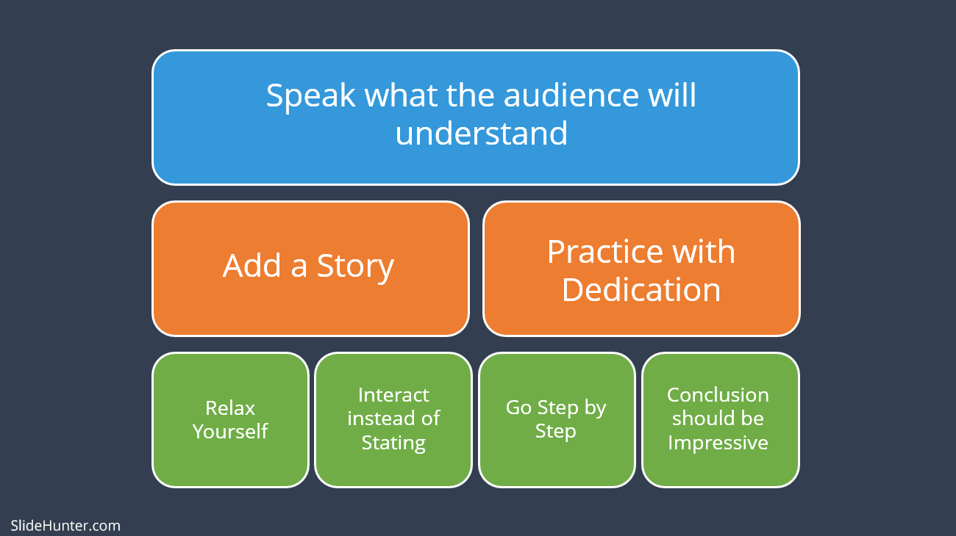

Slide 63

Tips to Improve Your PowerPoint Presentation

Slide 64
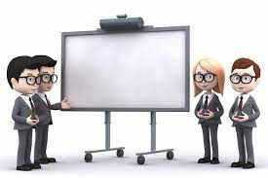
Do’s and Don’ts Tips for an Effective Presentation
DON’T’S
Turn your back to the audience.
Have no eye contact during your presentation or fix your eye contact on one person.
Talk and do something else at the same time.
Move constantly in front of the audience.
Move your hands too much.
Fold your arms either on your front or your back.
Keep your hands in your pockets during your presenting.
DO’S
Familiarize yourself with the equipment before presenting.
Use simple sentences.
Use examples to illustrate your ideas.
Practice your presentation.
Breathe deeply, relax and smile at your audience before presenting.
Use body language to reflect the content of the presentation.
Make eye contact with audience.

Slide 65
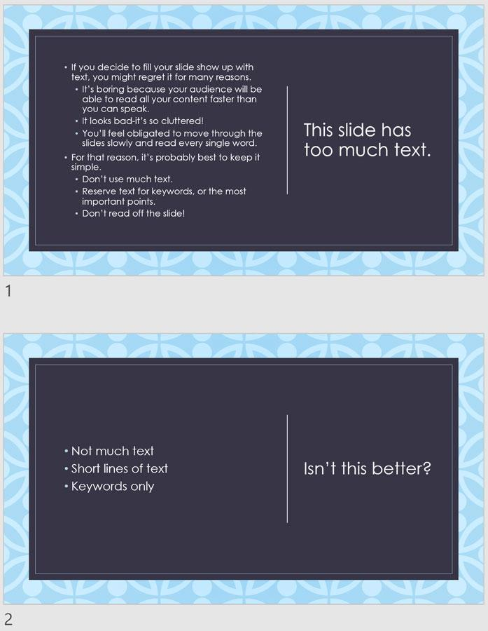
Follow the 5/5/5 rule:
To keep your audience from feeling overwhelmed, you should keep the text on each slide short and to the point. Some experts suggest using the 5/5/5 rule: no more than five words per line of text, five lines of text per slide, or five text-heavy slides in a row.

Slide 66

Don't read your presentation straight from the slides:
If your audience can both read and hear, it’s a waste of time for you to simply read your slides aloud. Your audience will zone out and stop listening to what you’re saying, which means they won’t hear any extra information you include.
Instead of typing out your entire presentation, include only main ideas, keywords, and talking points in your slide show text. Engage your audience by sharing the details out loud.

Slide 67

Choose readable colors and fonts:
Your text should be easy to read and pleasant to look at. Large, simple fonts and theme colors are always your best bet. The best fonts and colors can vary depending on your presentation setting. Presenting in a large room? Make your text larger than usual so people in the back can read it. Presenting with the lights on? Dark text on a light background is your best bet for visibility.

Slide 68
Guess the Dos and Don'ts
🗹
Organize your information
🗹
Keep it legible
🗹
Limit use effects
X
Overuse transitions, animations and sound
🗹
Add graphics
🗹
Avoid crowding your slides
🗹
Ensure design consistency
X
Put everything on one slide

Slide 69
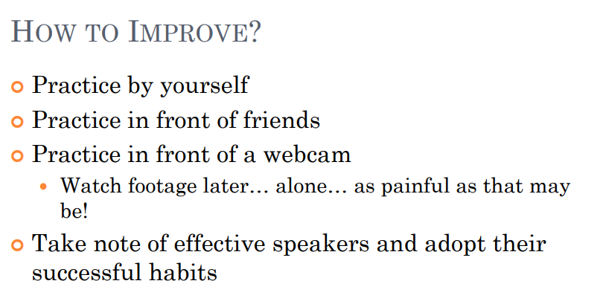


Slide 70

ANY QUESTIONS?

